Slide 1


Slide 2


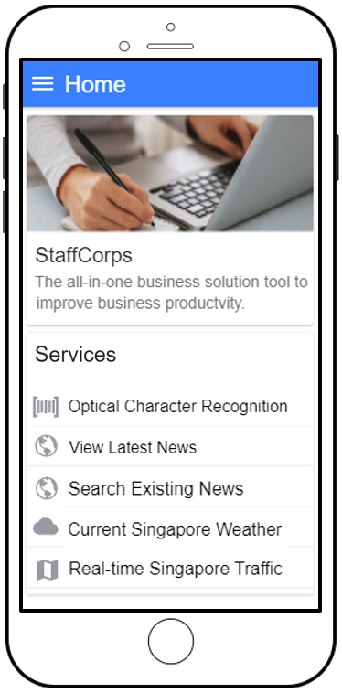


StaffCorps
The All-in-one
Business Solution
Progressive-Web-App
Stop typing out documents,
Just copy and paste
Be up-to-date,
Don’t let competitors be ahead
Be trendy,
Know about today’s business
Get weather reports,
Don’t fall victim to the rain
View real-time road traffic images,
Don’t be late for work

Slide 3

StaffCorps
The All-in-one
Business Solution
Progressive-Web-App
Stop typing out documents,
Just copy and paste
Be up-to-date,
Don’t let competitors be ahead
Be trendy,
Know about today’s business
Get weather reports,
Don’t fall victim to the rain
View real-time road traffic images,
Don’t be late for work
By: Tan Wei Jun, Terris

Slide 4

